Slide 1



Slide 1
SOFTWARE ENGINEERING PROJECT- I I (WEB PROGRAMMING) -SWE332
RESTAURANT OFFER HUB
DEPARTMENT OF SOFTWARE ENGINEERING
DAFFODIL INTERNATIONAL UNIVERSITY

Slide 2


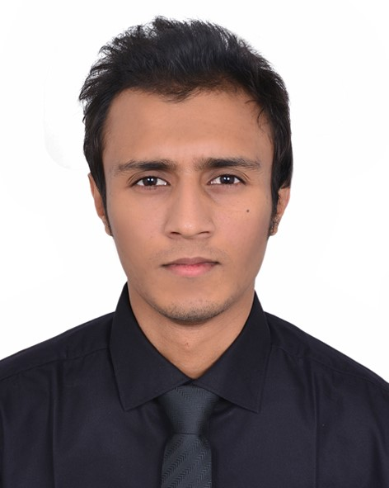
Slide 10
THE TEAM
IBNE SAYAD
MD. TANVIR SADIK RAJ
172-35-2115
ASIF KHAN SHAKIR
172-35-2111
CONTRIBUTOR
CONTRIBUTOR
SENIOR LECTURER
COURSE TEACHER & PROJECT MENTOR
DEPARTMENT OF SOFTWARE ENGINEERING
DAFFODIL INTERNATIONAL UNIVERSITY

Slide 3
Slide 3
THE FOLLOWING TOPICS ARE
1
2
3
4
BACKGROUND
OBJECTIVE
MOTIVATION
GOAL
5
6
7
TECHNOLOGIES
DIAGRAMS
CONTRIBUTION

Slide 4



Slide 2
BACKGROUND
NEW EXPERIENCE
Some systems are partially providing these services.
They are not complete and also not well arranged.
RESTAURANT & CUSTOMER RELATIONSHIP
Strong relationship between the restaurant & the customer.
Visit one site and get all you need.
EXTRA FEATURE ALSO
Users will experience with some unique & glorious features also.
Will save your time will make your life easier.

Slide 5

Slide 5
OBJECTIVE
RESTAURANTS CAN POST DIFFERENT TYPES OF OFFERS TIME TO TIME
USER CAN BOOK THEIR TABLE(S) IF THEY WANT
USER CAN CREATE CHAT ROOM WITH THEIR FRIENDS
USER WILL GET NOTIFIED FOR NEW & ATTRACTIVE OFFER(S)
USER CAN ORDER FOOD FROM HOME WHAT THEY ARE CHOOSING
FOOD VLOGGER CAN POST THEIR REVIEW VIDEOS FOR USERS
THERE WILL BE A COMMON PHOTO GALLERY.
RESTAURANT CAN PUBLISH ADVERTISE BY PAYING TO THE ADMIN.

Slide 6

Slide 6
MOTIVATION
RESTAURANT BUSINESS WILL BE MORE BENIFICIAL.
CUSTOMER WILL GET ADVANTAGE TO CHOOSE A RESTAURANT.
THE RESTAURANT SERVICE WILL BE MORE EFFECTIVE.

Slide 7
Slide 6
GOAL
WILL REMOVE THE BARIER BETWEEN RESTAURANT AND CUSTOMER.
WILL PROVIDE BUDGET FRIENDLY OFFERS.
WILL INSPIRE NEW ENTREPRENEURS TO START RESTURANT BUSINESS.

Slide 8
Slide 7
TECHNOLOGIES
LANGUAGE
FRAMEWORK
PHP
.JS
MYSQL
HTML
CSS
MATERIALIZE
LARAVEL
EDITOR: VISUAL STUDIO CODE
DATABASE: XAMPP
VERSION CONTROL: GITHUB

Slide 9
Slide 9
USE CASE DIAGRAM
FOR USER

Slide 10
Slide 9
USE CASE DIAGRAM
FOR RESTAURANT

Slide 11
Slide 9
USE CASE DIAGRAM
FOR ADMIN

Slide 12
Slide 9
USE CASE DIAGRAM
FOR SYSTEM

Slide 13
Slide 9
ACTIVITY DIAGRAM
FOR USER

Slide 14
Slide 9
ACTIVITY DIAGRAM
FOR RESTAURANT

Slide 15
Slide 9
ACTIVITY DIAGRAM
FOR ADMIN

Slide 16
Slide 9
CLASS DIAGRAM
FOR ROH

Slide 17
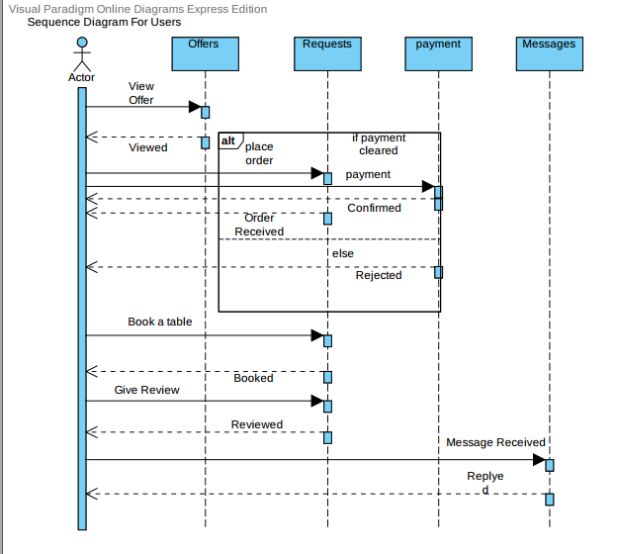
Slide 9
SEQUENCE DIAGRAM
FOR USER

Slide 18
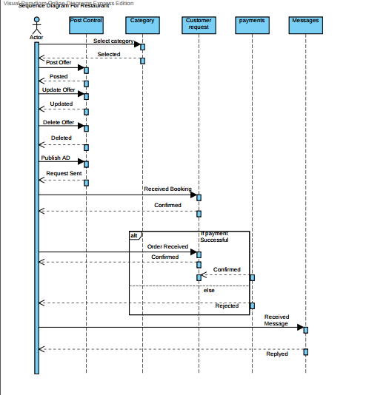
Slide 9
SEQUENCE DIAGRAM
FOR RESTAURANT

Slide 19
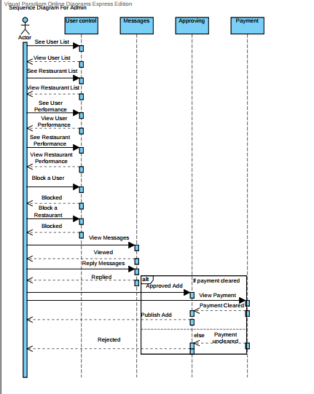
Slide 9
SEQUENCE DIAGRAM
FOR ADMIN

Slide 20
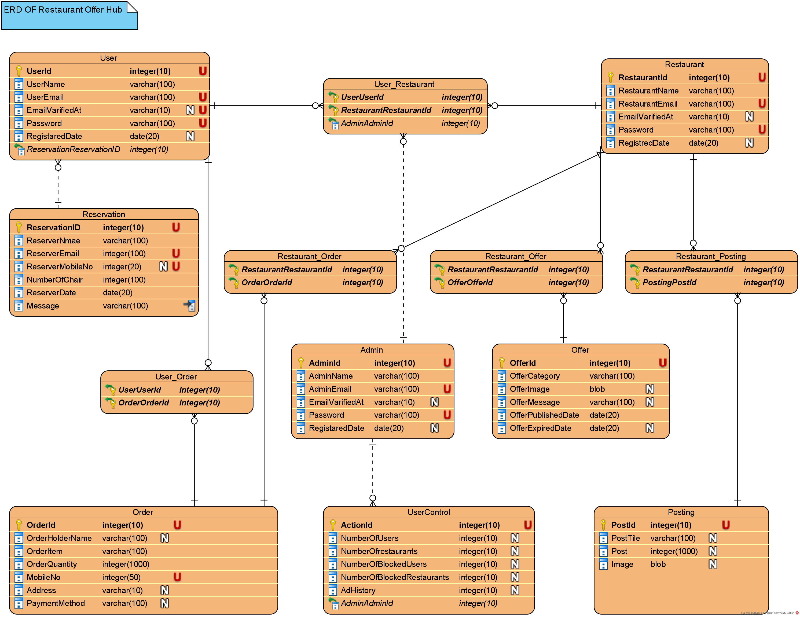
Slide 9
ER DIAGRAM
FOR ROH

Slide 21
Slide 13
CONTRIBUTION
IBNE SAYAD
MD. TANVIR SADIK RAJ
FRONT END
BACK END
SRS
SRS
USE CASE
SEQUENCE DIAGRAM
ACTIVITY DIAGRAM
ERD
CLASS DIAGRAM
CLASS DIAGRAM
CODE
CODE
USER PORTAL
ADMIN PORTAL
OFFER POSTING
RESERVATION

Slide 22

Slide 15
THANK YOU!

